Slide 1


KEYPHRASE EXTRACTION FROM SCIENTIFIC ARTICLES

Slide 2

AGENDA
01
04
INTRODUCTION
METHODOLOGY
02
05
07
DATASET USED
CODE SNIPPET
CONCLUSION
03
06
RAKE ALGORITHM
COMPARISONS

Slide 3


INTRODUCTION
Keyphrase extraction from scientific articles is a crucial task in natural language processing (NLP) that aims to automatically identify and extract key phrases that represent the main topics or concepts discussed in a given document. In this project, we propose a novel approach for keyphrase extraction from scientific articles using a combination of techniques, including natural language processing, machine learning, and domain-specific Knowledge. Overall, our project contributes to the advancement of NLP techniques for Keyphrase extraction and has the potential to enhance information retrieval and Knowledge discovery in scientific literature.
.

Slide 4

DATASET USED
1. Dataset Source: The dataset used for keyphrase extraction comprises merged scientific articles, ensuring a comprehensive and varied selection of text for analysis.
2. Merging Process: To create the dataset, individual scientific articles are combined into a single file. This merging process can be done manually, where articles are copied and pasted into a unified document, or through an automated tool designed for merging text content.
3. Benefits of Merged Dataset: The merging of articles provides several advantage Increased Accuracy: The merged dataset offers a more diverse and extensive range of scientific content, which can lead to higher accuracy in keyphrase extraction.
Comprehensive Coverage: By merging multiple articles, the dataset covers a broader spectrum of topics, ensuring that the keyphrase extraction model is robust and adaptable to various scientific domains.
Enhanced Generalization: The merged dataset allows the keyphrase extraction model to generalize better, as it is trained on a more diverse set of text inputs.
4. Methodology Utilization: The methodology for keyphrase extraction is applied to the merged dataset, taking advantage of its comprehensive nature to produce accurate and relevant keyphrases.

Slide 5

RAKE ALGORITHM
The RAKE (Rapid Automatic Keyword Extraction) algorithm is a widely used method for extracting keyphrases from text documents.
It is designed to quickly and efficiently identify important terms and phrases that represent the main topics or themes of a document.
RAKE is particularly useful for tasks such as document summarization, information retrieval, and content analysis.
The key advantages of the RAKE algorithm is its simplicity and efficiency.
It does not rely on complex linguistic rules or require extensive training data, making it easy to implement and apply to a wide range of text analysis tasks.
Overall, the RAKE algorithm is a valuable tool for extracting keyphrases from text documents, providing a straightforward and effective way to identify important terms and phrases that capture the essence of the document's content.

Slide 6

ADVANTAGES
Simplicity: RAKE is easy to implement and understand, making it accessible for beginners.
Efficiency: It is computationally efficient and can process large amounts of text quickly.
Language Independence: RAKE does not rely on language-specific resources like dictionaries, making it suitable for different languages.
Effectiveness: Despite its simplicity, RAKE often performs competitively with more complex algorithms for keyphrase extraction.
Lack of Context: RAKE does not consider the context of words within the text, which can lead to extracting irrelevant keyphrases.
Sensitivity to Parameters: The performance of RAKE can be sensitive to the parameters used for candidate selection and scoring.
Difficulty with Short Texts: RAKE may not perform well with very short texts where context is limited.
LIMITATIONS

Slide 7
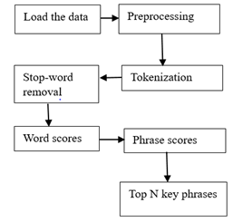
METHODOLOGY
Here's a general outline of the methodology:
Data Preprocessing
Feature Extraction
Model Selection
Training and Validation
Evaluation
Parameter Tuning
Results Analysis
Overall, the methodology for Keyphrase extraction from the Scientific articles involved a systematic approach to data preprocessing, feature extraction, model selection, training, evaluation, and analysis to develop an efficient and effective keyphrase extraction model.

Slide 8


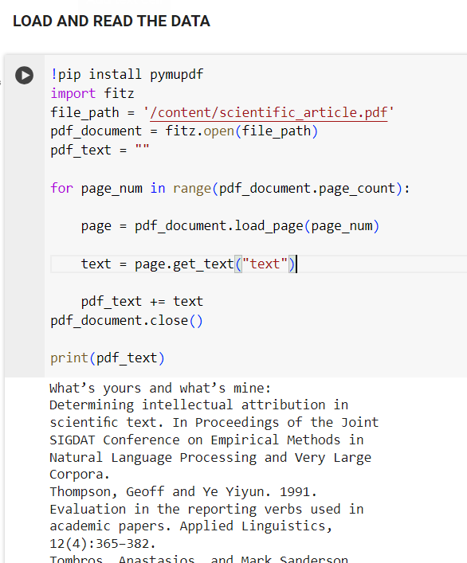
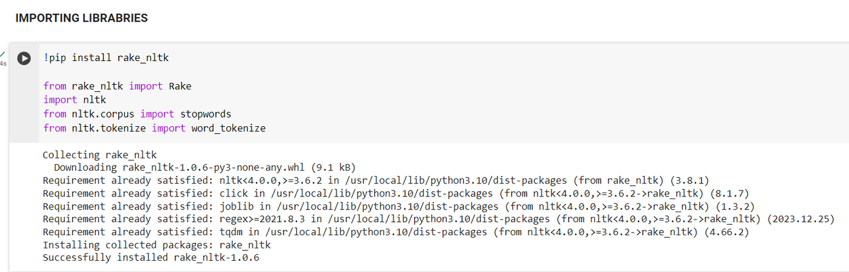
CODE SNIPPET

Slide 9
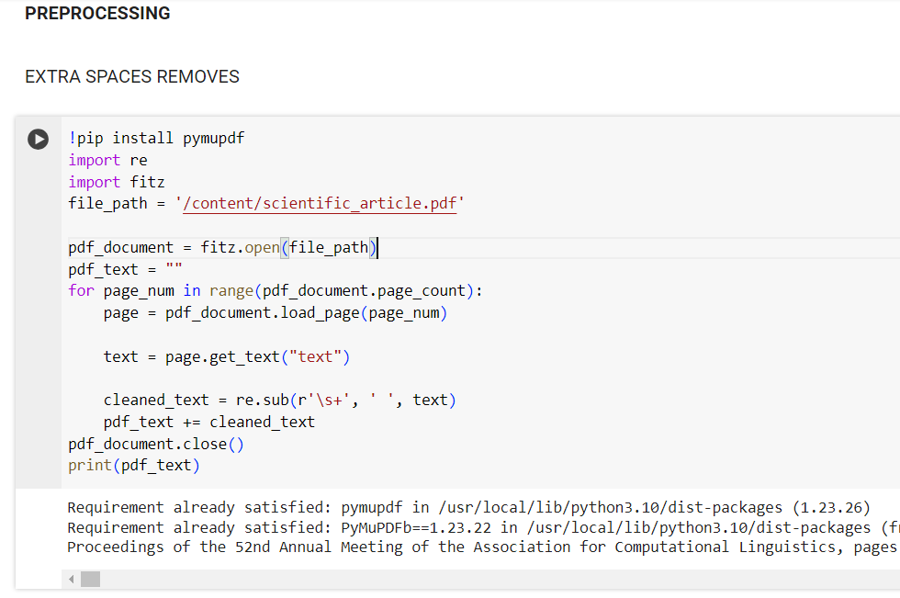
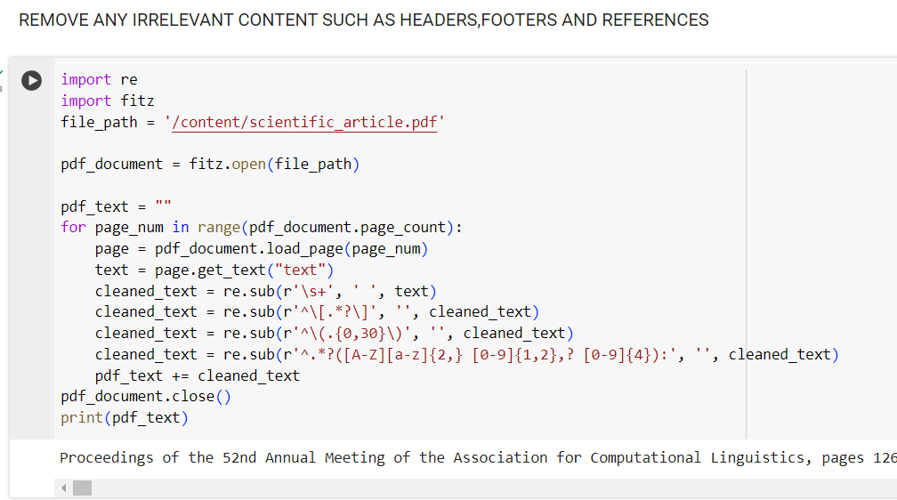

Slide 10
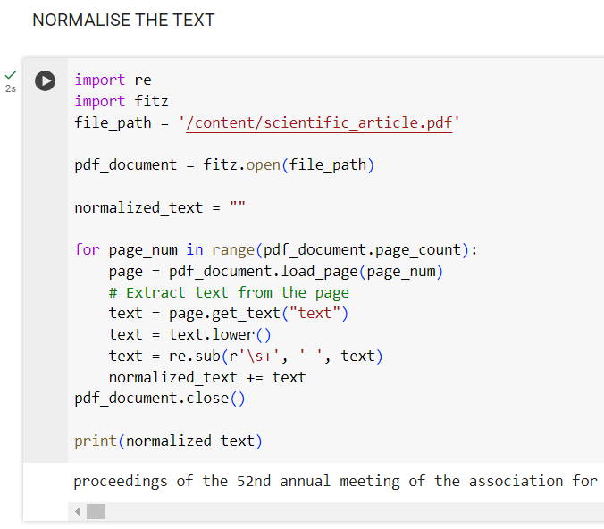
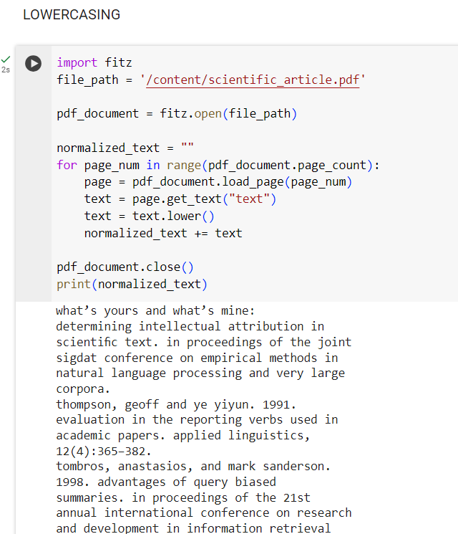

Slide 11
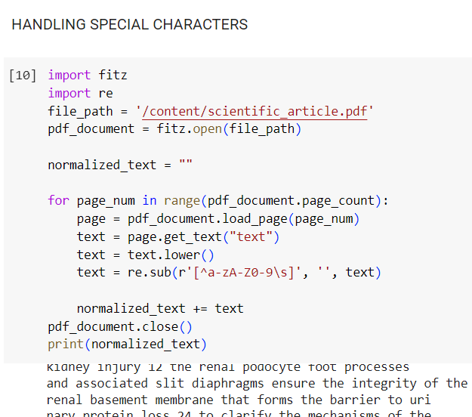
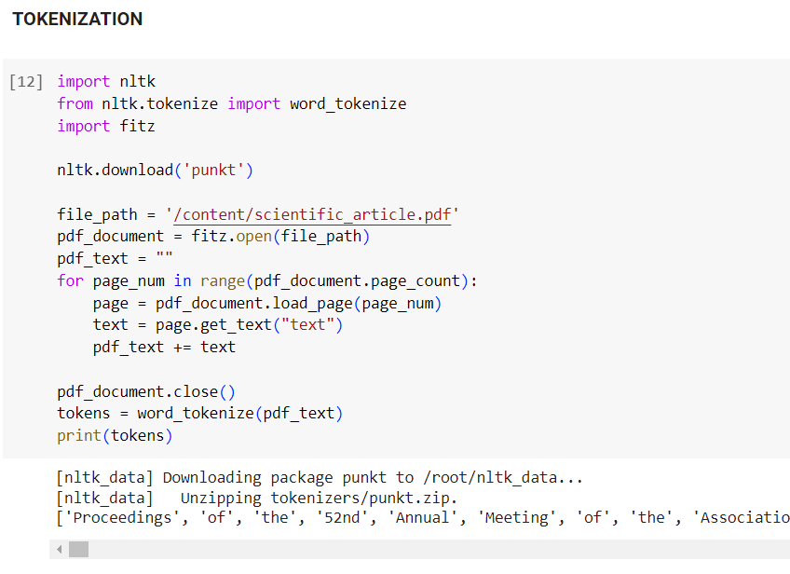

Slide 12
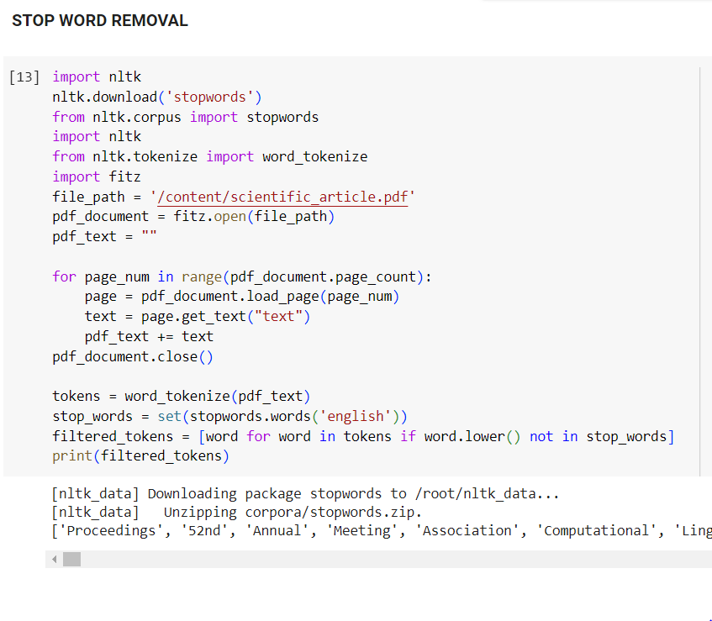
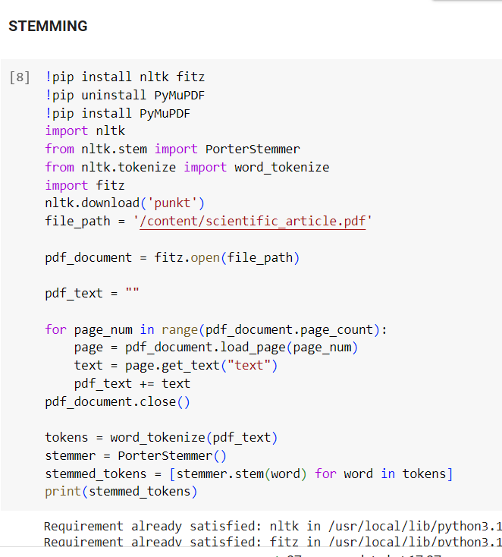

Slide 13
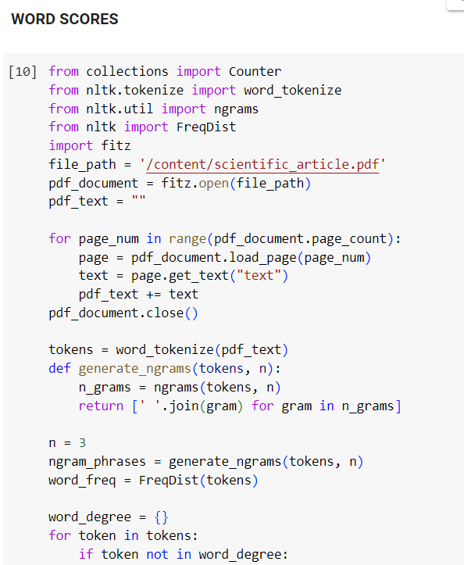
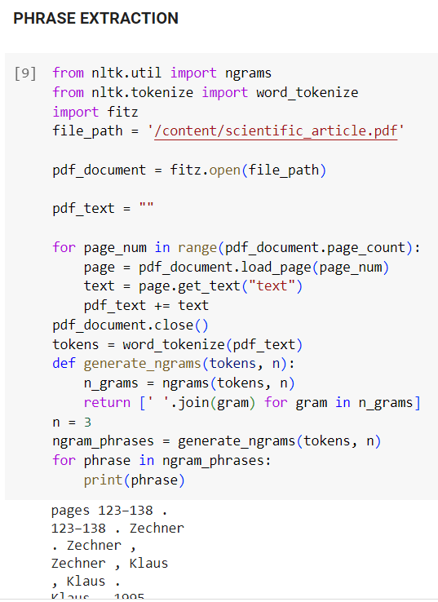
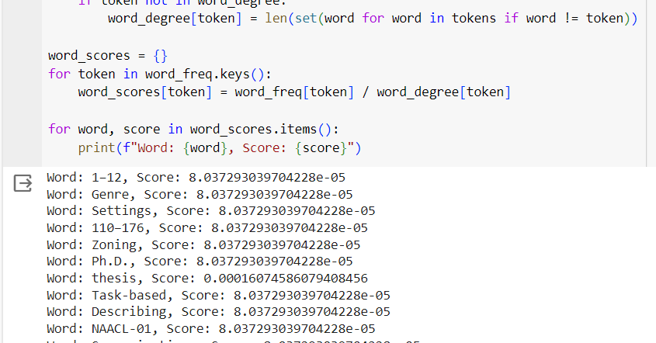

Slide 14
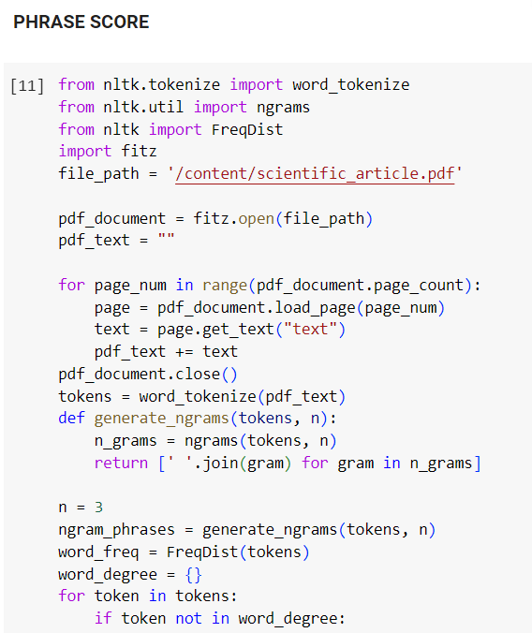
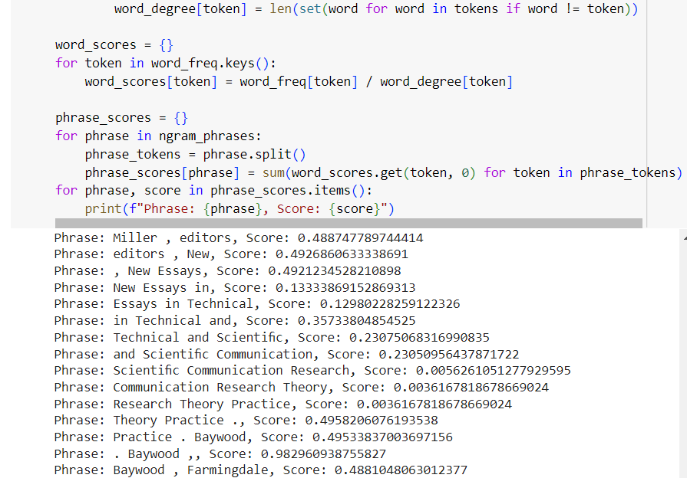

Slide 15
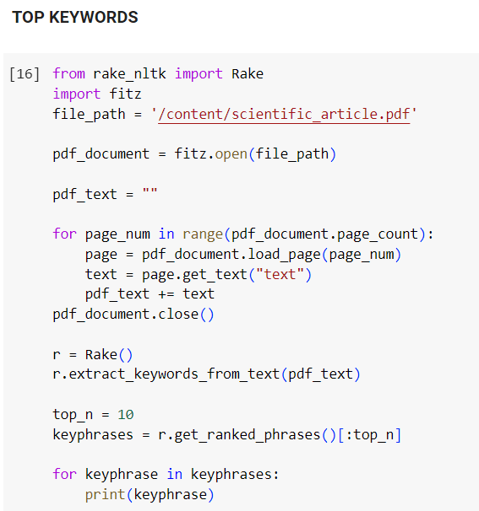
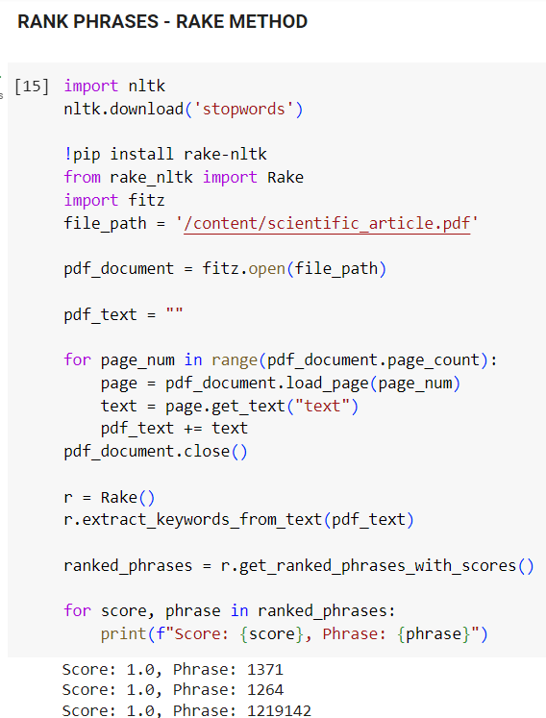
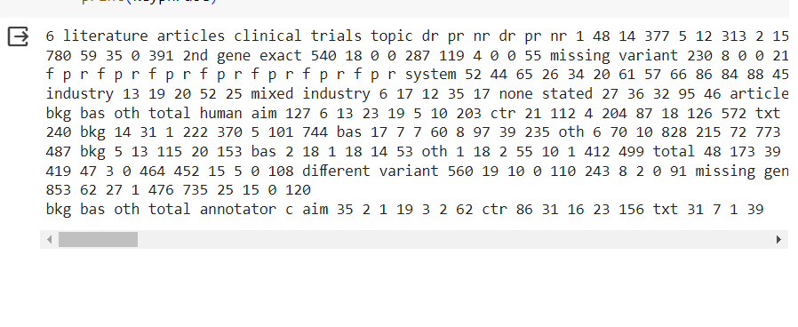

Slide 16
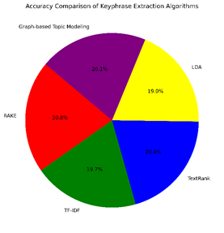
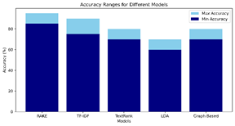
COMPARISONS
ALGORITHM COMPARISON
MODEL VS ACCURACY

Slide 17

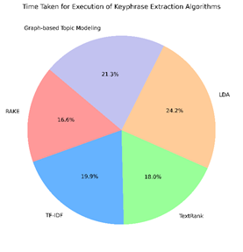
ACCURACY COMPARISON

Slide 18
CONCLUSION
We analyze the performance of our keyphrase extraction system on a scientific publication dataset. The results show that the RAKE-based approach correctly extracts keyphrases with an accuracy of 92%, further confirming its effectiveness in real-world applications.
By solving these issues and focusing on future development, Key phrase extraction from scientific articles project can have a substantial impact on the scientific community by increasing the accessibility and usability of scientific publications.

Slide 19

OUR TEAM
B.TANU SREE
21BCE9938
M.JAIDEEP
21BCE8801
A.SADHANA
21BCE9924

Slide 20

THANK YOU!!

